Slide 1

Analyze This: The Analysis of Hollywood Films and the correlation to their success
Project 1
UW Extended Campus – Data Analytics Bootcamp
Raina Everson
Louis Alejandro Gonzalez
Adam Salinas
Kevin Schuirmann

Slide 2
Project Overview
Movie Metadata CSV file via Kaggle
Range of years: 2010 to 2020

Slide 3
Project Overview
Question 1: What genre performed the best for the given years? The worst?
Question 2: Revenue vs Movie Rating?
Question 3: Movie Rating vs Budget?

Slide 4
What genre performed the best for the given years? The worst?

Slide 5
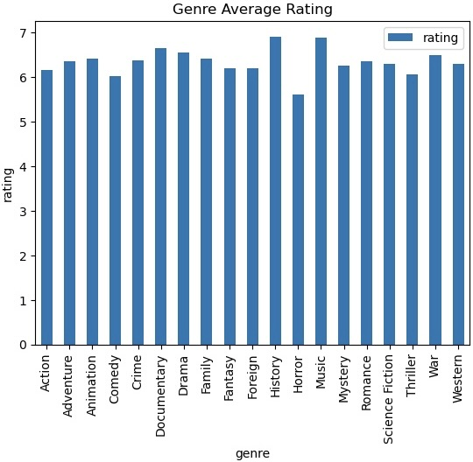
What genre performed the best for the given years? The worst?
Top 5: History, Music, Documentary, War, and Drama
Bottom 5: Horror, Comedy, Thriller, Action, Fantasy & Foreign

Slide 6
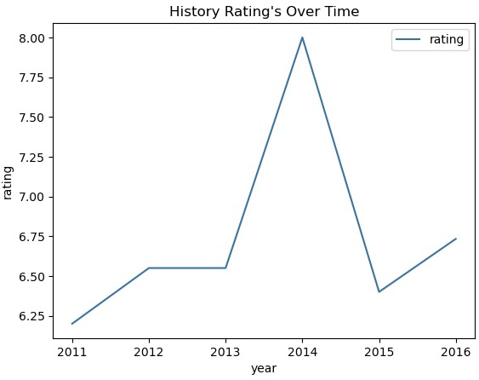
What genre performed the best for the given years? The worst? (cont’d)
Several reasons why historical movies rate well:
Strong performances
Budget
Revenue
Rich storytelling
Connections to real events
Reflecting on the past

Slide 7
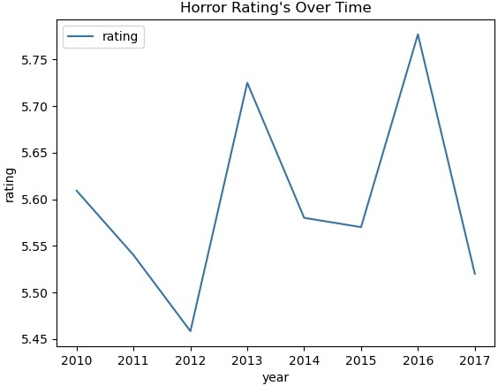
What genre performed the best for the given years? The worst? (cont’d)
Several reasons why horror movies receive poor ratings:
Formulaic storytelling
Budget
Revenue
Quality variation
Lack of originality
Subjective preferences

Slide 8
Analysis of Revenue vs Movie Rating

Slide 9
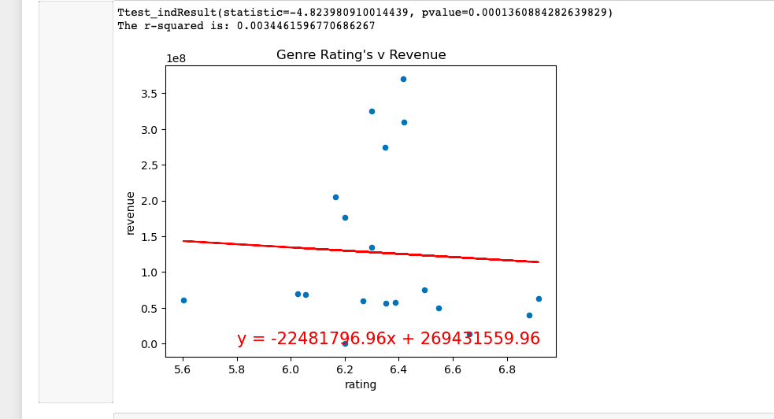
Analysis of Revenue vs Movie Rating
Action movies did very well in the box office during the 2010’s
Family-oriented animation films have consistently performed well in both ratings and revenue.
Comedy and horror movies had mixed ratings during the 2010’s.

Slide 10
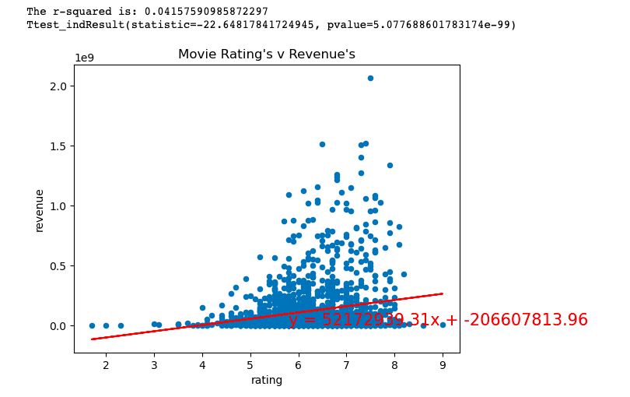
Analysis of Revenue vs Movie Rating (cont’d)
Critically acclaimed movies did very well in the box office.
Ex: The Dark Knight Rises
Some action movies were financially successful despite not receiving equally high ratings.
Ex: Transformers franchise
Some movies with smaller budgets managed to achieve significant box office success despite lower ratings.
Ex: Get Out

Slide 11
Analysis of Movie Rating vs Budget

Slide 12
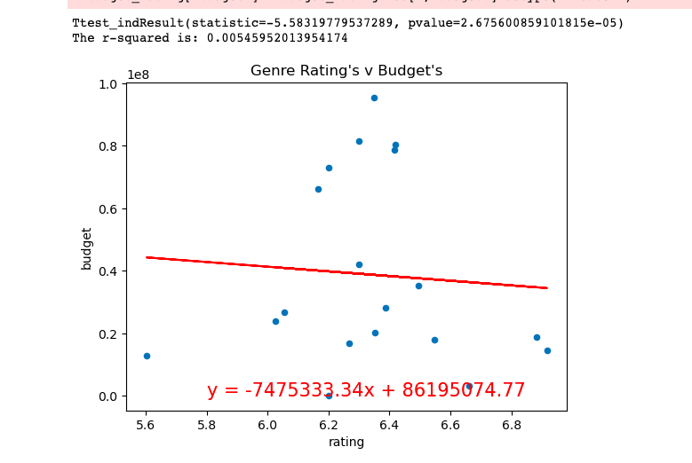
Analysis of Movie Rating vs Budget
Action movies often user higher budgets
Drama movies may have higher budgets, but rely on other factors
High budget comedies have produced positive and negative reviews

Slide 13

Analysis of Movie Rating vs Budget (cont’d)
Common for high-budget films to receive critical acclaim.
Not as common, but low budget films also received critical acclaim.
Both types of movies relied on different factors.

Slide 14
Conclusions?

Slide 15
Questions?

